Slide 1
ETHICAL AND PROFESSIONAL ISSUES IN COMPUTING
PART 1
Chapter 2: Computer Ethics

Slide 2
COMPUTER ETHICS
INTENDED LEARNING OUTCOMES
State the Code of Ethics of Filipino IT Professionals;;
Apply the Principles formulated by the Association of Computing Machinery in dealing with other people, in making judgement, in software designs and all other dealings in the exercise of the IT profession;
Explain the Ten Commandments of Computer Ethics;
Identify problems in a work scenario;
Be a morally responsible student;
Manifest ethical thinking skills in analyzing and justifying computing issues

Slide 3

COMPUTER ETHICS
INTRODUCTION
What is Computer Ethics?
What is Code of Ethics of the Filipino IT Professionals?
What is the Code of Ethics of Association of Information Technology Professionals (AITP)?
What are the Ten Commandments of Computer Ethics?

Slide 4

COMPUTER ETHICS
Professional Code of Ethics
It is a set of guidelines which are designed to set out acceptable behaviour of member of a particular group, association or profession.

Slide 5
COMPUTER ETHICS
Benefits of Ethical Guidelines
Ethical Decision Making
High Standards of Practice and Ethical Behavior
Trust and Respect from the General Public
Evaluation Benchmark

Slide 6
Code of Ethics of the Filipino IT Professionals
1. I will promote public knowledge, understanding and appreciation of I.T
2. I will consider the general welfare and public welfare and public good in the performance of my work.
3. I will advertise goods or professional services in a clear and truthful manner
4. I will comply and strictly abide by the intellectual property laws, patent laws and other related laws in respect of I.T
5. I will accept the full responsibility for the work undertaken and utilize my skills with competence and professionalism.
6. I will make truthful statements on my areas of competence as well as the capabilities and qualities of my product and services
7. I will not disclose or use any confidential information obtained in course of professional duties without the consent of the parties concerned except when required by the laws.
8. I will strive to attain the highest quality in both the products and services that offer.
9. I will knowingly participate in the development of the Information Technology.
10. I will uphold and improve the IT professional’s standard through continuing profession in order to enhance the IT profession.

Slide 7
COMPUTER ETHICS
Computer Ethics
What is your own understanding of Computer Ethics?
What are the problems in Computer Ethics?

Slide 8
COMPUTER ETHICS
Computer Special Case
Logical Malleability
Impact on Society
Invisibility Factor
Invisible Use
Invisible Complex
calculation
Invisible Programming

Slide 9
COMPUTER ETHICS
Three “Levels” of Computer Ethics
“pop” computer ethics
“para” computer ethics
“theoretical” computer ethics

Slide 10
COMPUTER ETHICS
Moral Responsibilities of Computer Professionals
Do good or cause harm
Enable others to do good or cause harm
Influence others to do good or cause harm

Slide 11
COMPUTER ETHICS
Code of Ethics of Association of Information Technology Professionals (AITP)
* I have an obligation to Management
* That I have an obligation to my fellow members
* That I have an obligation to society
* That I have an obligation to my College or University
* That I have an obligation to my country
* I accept these obligations

Slide 12
COMPUTER ETHICS
Principles of the Association of Computing Machineries
Principle 1: Public
Principle 2: Client and Employer
Principle 3: Product
Principle 4: Judgment
Principle 5: Management
Principle 6: Profession
Principle 7: Colleagues
Principle 8: Self

Slide 13
COMPUTER ETHICS
The Ten Commandments of Computer Ethics
Defined by the Computer Ethics Institute that will serve as a moral guideline in the use of computers.

Slide 14
THOU SHALT NOT USE A COMPUTER TO HARM OTHER PEOPLE

Slide 15
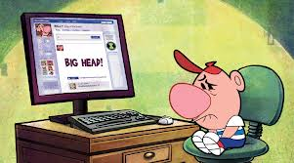
COMPUTER ETHICS

Slide 16
THOU SHALT NOT INTERFERE WITH OTHER PEOPLE'S COMPUTER WORK

Slide 17
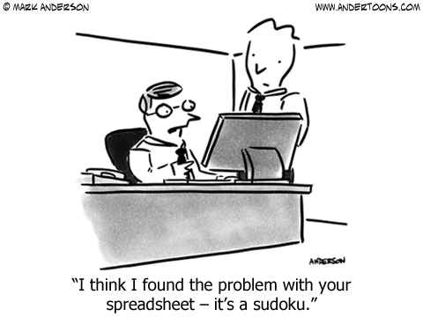
COMPUTER ETHICS

Slide 18
THOU SHALT NOT SNOOP AROUND IN OTHER PEOPLE'S COMPUTER FILES

Slide 19

COMPUTER ETHICS

Slide 20
THOU SHALT NOT USE A COMPUTER TO STEAL

Slide 21
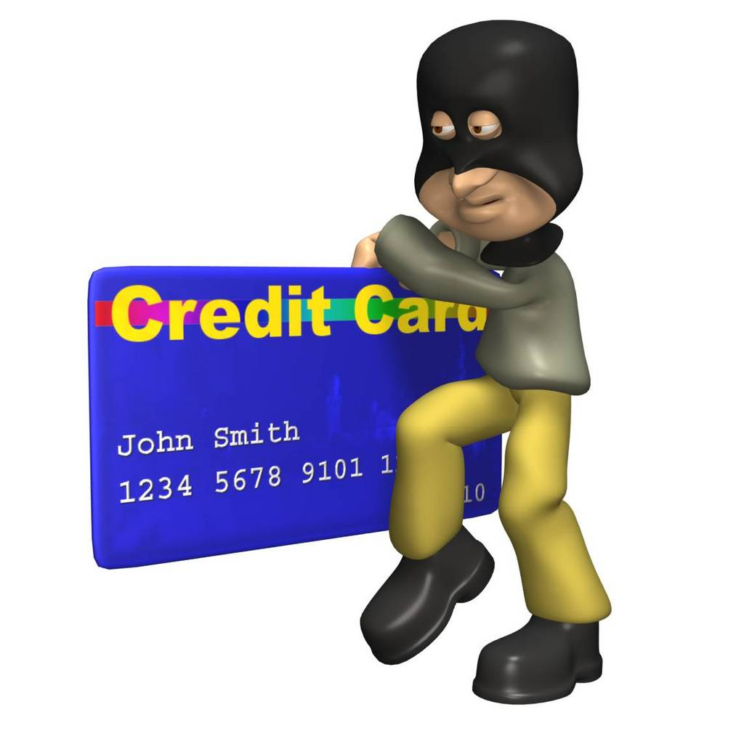
COMPUTER ETHICS

Slide 22
THOU SHALT NOT USE A COMPUTER TO BEAR FALSE WITNESS

Slide 23
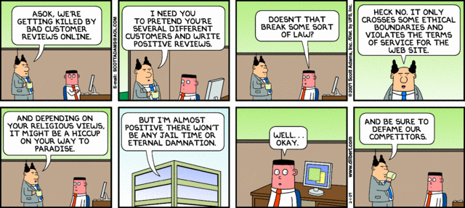
COMPUTER ETHICS

Slide 24
THOU SHALT NOT COPY OR USE PROPRIETARY SOFTWARE FOR WHICH YOU HAVE NOT PAID

Slide 25

COMPUTER ETHICS

Slide 26
THOU SHALT NOT USE OTHER PEOPLE'S COMPUTER RESOURCES WITHOUT AUTHORIZATION OR PROPER COMPENSATION

Slide 27

COMPUTER ETHICS

Slide 28
THOU SHALT NOT APPROPRIATE OTHER PEOPLE'S INTELLECTUAL OUTPUT

Slide 29
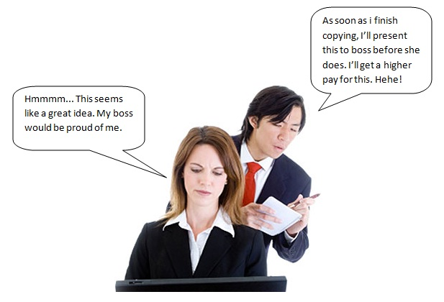
COMPUTER ETHICS

Slide 30
THOU SHALT THINK ABOUT THE SOCIAL CONSEQUENCES OF THE PROGRAM YOU ARE WRITING OR THE SYSTEM YOU ARE DESIGNING

Slide 31
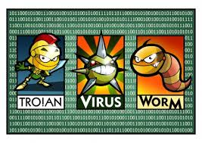
COMPUTER ETHICS

Slide 32
THOU SHALT ALWAYS USE A COMPUTER IN WAYS THAT INSURE CONSIDERATION AND RESPECT FOR YOUR FELLOW HUMANS

Slide 33

COMPUTER ETHICS

Slide 34
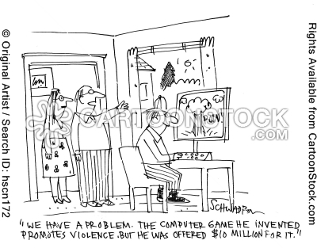
COMPUTER ETHICS

Slide 35
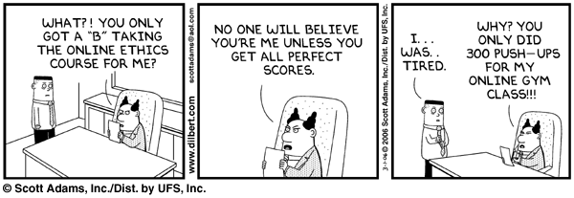
COMPUTER ETHICS

Slide 36
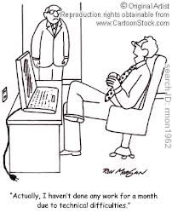
COMPUTER ETHICS

Slide 37
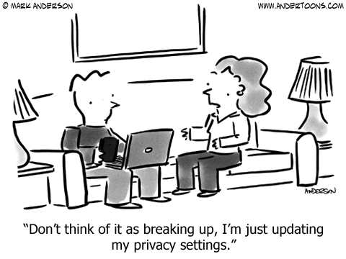
COMPUTER ETHICS

Slide 38
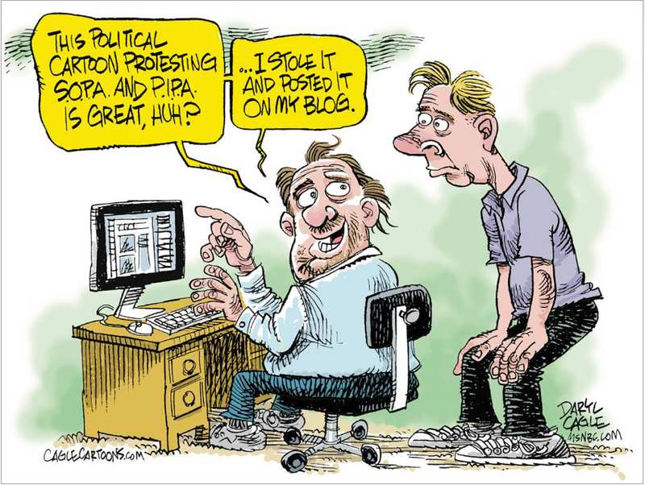
COMPUTER ETHICS

Slide 39
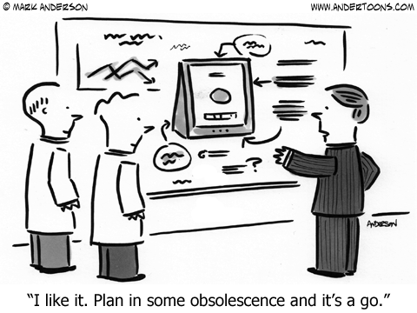
COMPUTER ETHICS

Slide 40
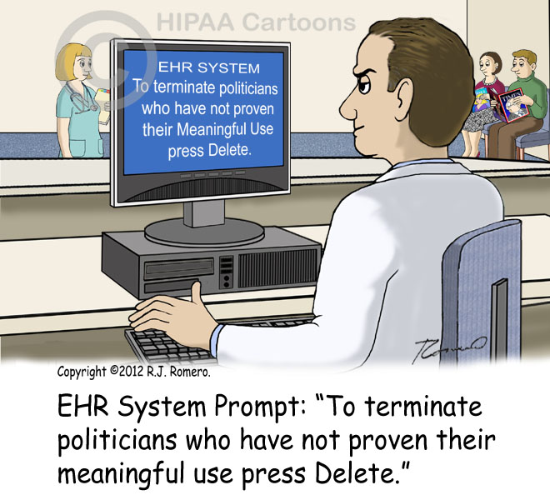
COMPUTER ETHICS

Slide 41
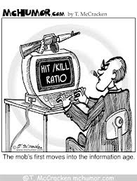
COMPUTER ETHICS

Slide 42
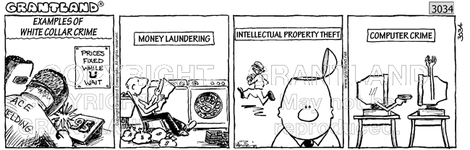
COMPUTER ETHICS

Slide 43
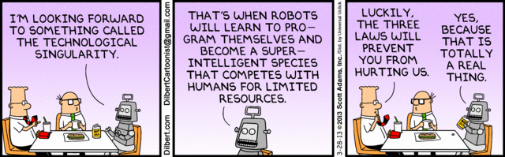
COMPUTER ETHICS

Slide 44
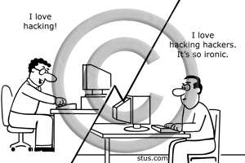
COMPUTER ETHICS

Slide 45
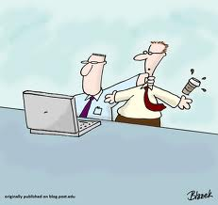
COMPUTER ETHICS

Slide 46
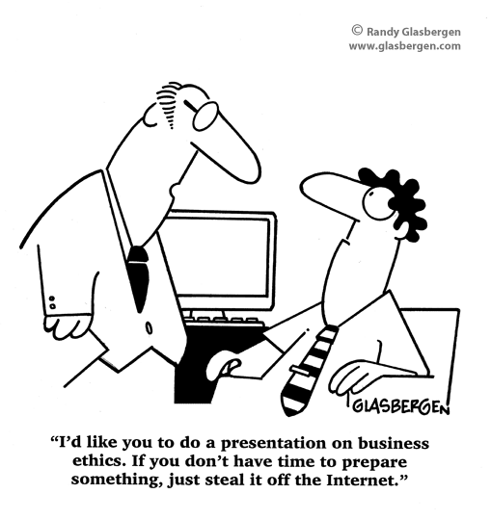
COMPUTER ETHICS

Slide 47
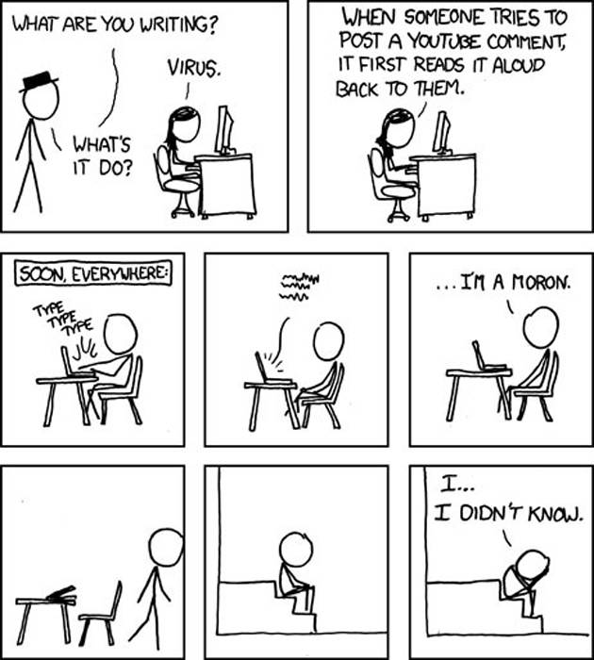
COMPUTER ETHICS

Slide 48
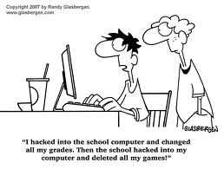
COMPUTER ETHICS

Slide 49
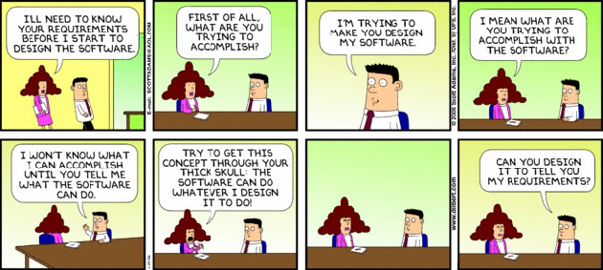
COMPUTER ETHICS

Slide 50
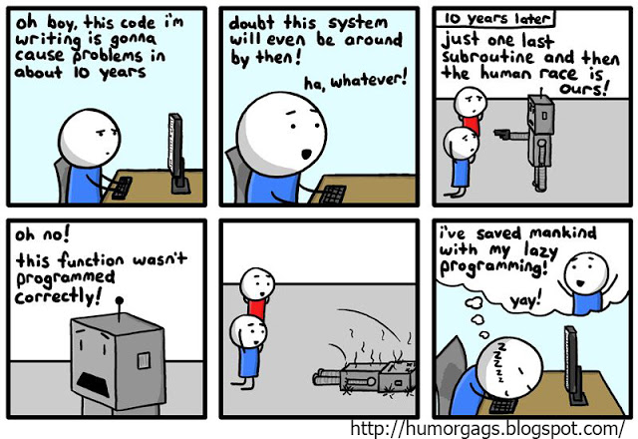
COMPUTER ETHICS

Slide 51
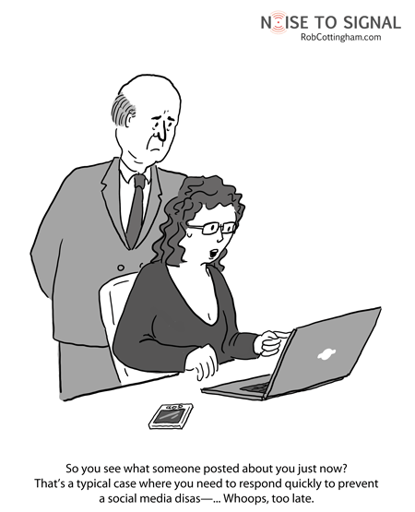
COMPUTER ETHICS

Slide 52
COMPUTER ETHICS
INTENDED LEARNING OUTCOMES
State the Code of Ethics of Filipino IT Professionals;;
Apply the Principles formulated by the Association of Computing Machinery in dealing with other people, in making judgement, in software designs and all other dealings in the exercise of the IT profession;
Explain the Ten Commandments of Computer Ethics;
Identify problems in a work scenario;
Be a morally responsible student;
Manifest ethical thinking skills in analyzing and justifying computing issues

Slide 53
Questions?

